Slide 1
Multi-channel
Engagement
Jill Jones
Subject Matter Expert
Notes:
Welcome, everybody. Thank you for joining Net Atlantic today for
<click>
Multi-channel Engagement: We’ll cover 9 Ways to Improve your Email Marketing Response in 2013 and 2014.
<slow down>
I’m Jill Jones, Subject Matter Expert at Net Atlantic, an Email Marketing Service Provider founded in 1995. This presentation covers the topics discussed in our white paper of the same name. Today we will cover 9 different concepts for using email marketing as the core of multi-channel engagement strategy, leaving 15 minutes at the end for questions. I am taking questions over the GotoWebinar interface.
<click>

Slide 2
What is
Multi-channel
Engagement?
jjones@netatlantic.com
Notes:
What is Multi-channel Engagement?
<click>
It is a new set of rules that puts you in continuous touch with customers, at any moment, on any medium.
<click>
It is centered on email, as opposed to a website, CRM tool, social media, blog, direct mail, or other media.
<click>
<slow down>
It combines all of these other online methods,
<click>
because email is really the only tool that can be used to tie the others together and maintain continuous touch with prospects and customers.
In short, Multi-channel Engagement is a shift in the way you use email marketing.
<click>
Are you ready for Multi-channel Engagement? The answer is yes, because most of these nine concepts are already well known.
<click>

Slide 3
Centered on email
What is
Multi-channel
Engagement?
Combines all online methods
Are you ready?
Maintains continuous touch
jjones@netatlantic.com
Notes:
What is Multi-channel Engagement?
<click>
It is a new set of rules that puts you in continuous touch with customers, at any moment, on any medium.
<click>
It is centered on email, as opposed to a website, CRM tool, social media, blog, direct mail, or other media.
<click>
<slow down>
It combines all of these other online methods,
<click>
because email is really the only tool that can be used to tie the others together and maintain continuous touch with prospects and customers.
In short, Multi-channel Engagement is a shift in the way you use email marketing.
<click>
Are you ready for Multi-channel Engagement? The answer is yes, because most of these nine concepts are already well known.
<click>

Slide 4
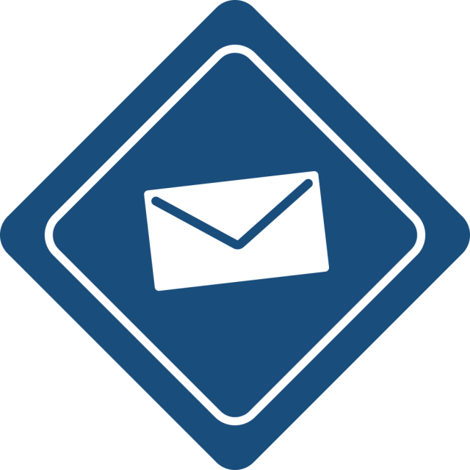
Email Marketing
Drives
Multi-channel
Engagement
jjones@netatlantic.com
Notes:
First, we cover how Email Marketing Drives Multi-channel Engagement should be the backbone of your marketing strategy. This is about thinking of the entire Internet as your website, rather than one group of pages on it.
<click>

Slide 5
http://
jjones@netatlantic.com
Notes:
Let’s start with a blinding glimpse of the obvious; the online environment is now entrenched as the media of choice for consumers and business leaders.
You use various web techniques for websites, landing pages, ‘drip’ email campaigns, social media and even blogs.
<slow down>
Despite all this envelope-pushing, for many companies, their website is still central to their marketing strategy, not email.
<click>

Slide 6
WELCOME
jjones@netatlantic.com
Notes:
The idea is to think of the internet as your universe and you are driving folks to your house to generate traffic. You need to give your customers clear direction on how to get to and interact with your channels. You’re not abandoning your site’s utility, but realigning its central role in your marketing strategy.
Why? Your website can’t actively get onto someone’s desktop. Even social media benefits from email to support initiatives and movements.
That’s why you make email the center of your engagement strategy.
Your entire web presence becomes your site, managed differently for various demographics, vertical markets, or products and services. You create a unique path for each.
<click>

Slide 7
jjones@netatlantic.com
Notes:
Let’s start with a blinding glimpse of the obvious; the online environment is now entrenched as the media of choice for consumers and business leaders.
You use various web techniques for websites, landing pages, ‘drip’ email campaigns, social media and even blogs.
<slow down>
Despite all this envelope-pushing, for many companies, their website is still central to their marketing strategy, not email.
The idea is to think of the internet as your universe and you are driving folks to your house to generate traffic. You need to give your customers clear direction on how to get to and interact with your channels. You’re not abandoning your site’s utility, but realigning its central role in your marketing strategy.
Why? Your website can’t actively get onto someone’s desktop. Even social media benefits from email to support initiatives and movements.
That’s why you make email the center of your engagement strategy.
Your entire web presence becomes your site, managed differently for various demographics, vertical markets, or products and services. You create a unique path for each.
<click>

Slide 8
jjones@netatlantic.com
Notes:
Let’s start with a glimpse of what should be pretty obvious; the online environment is now entrenched as the media of choice for consumers and business leaders.
You use various web techniques for websites, landing pages, ‘drip’ email campaigns, social media and even blogs.
<slow down>
Despite all this envelope-pushing, for many companies, their website is still central to their marketing strategy, not email.
The idea is to think of the internet as your super highway and you are generating traffic to drive people to your street. You need to give your customers clear direction on how to get to and interact with your channels. You’re not abandoning your site’s utility, but realigning its central role in your marketing strategy.
Why? Your website can’t actively get onto someone’s desktop. Even social media benefits from email to support initiatives and movements.
That’s why you make email the center of your engagement strategy.
Your entire web presence becomes your site, managed differently for various demographics, vertical markets, or products and services. You create a unique path for each.
<click>

Slide 9
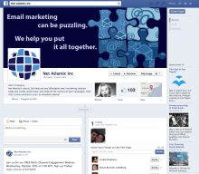
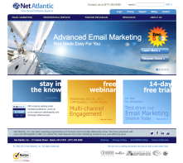
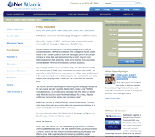
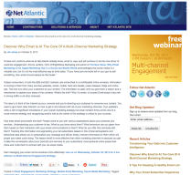
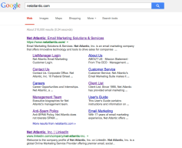
jjones@netatlantic.com
Notes:
Your website is still important as a place where you have complete control, but you have to bring people to it.
<click>
Social media is a good place to get in front of people, but you have zero control.
<click>
<slow down>
Press releases are always good exposure for your business, when they are timely and newsworthy. They help generate brand awareness and gain industry exposure.
<click>
Your online ads and directories help bring people to your landing pages, but managing them and getting them to perform can be frustrating and expensive. Through email marketing you can promote your ads and coupons.
<click>
Blogs are a necessary part of your marketing mix to help drive traffic and optimize your SEO.
<click>
The prospects and customers you target through these various channels are at different stages. Email lets you treat them differently through segmentation, customized merge fields, and triggered automation.
<slow down>
A perfect example of this is found on LinkedIn:
Whenever somebody posts a discussion or question to a group you belong to, or shares a news item, how do you know about it? You’ve already segmented yourself by joining, so the information is probably relevant. However, you remain out of reach because the site is static. It sits there, waiting for you.
So you get an email announcement from the group. You only know about what’s going on if you get the email. The site comes to you, using email. Great as LinkedIn is, it can’t do it alone. The point is that social media can be well targeted and viral, but often its ability to reach out relies on email, a tried and true method, in order to get the ball rolling.
Not just LinkedIn, but since the year 2000, we’ve seen all of these online outposts expand and drive powerful social interaction. In this next decade, we’ve already seen increased personalization, frequency, and relevancy and this is a trend that will continue to grow.
<click>

Slide 10
jjones@netatlantic.com
Notes:
Email is a valuable resource that ties all of these channels together. Multi-channel Engagement puts email at the center of your marketing efforts.
The prospects and customers you target through your various channels are at different stages, so an email strategy needs to be created with the sales cycle in mind. Email is still one of the most cost effective channels to nurture customers and prospects, since it engages them in a two-way dialogue where conversion and activity can be recorded and measured in real-time. Email lets you treat each differently through segmentation, customized merge fields, and triggered automation. In addition to supporting marketing messages in other channels, email benefits from pulling in content from other channels to boost relevance and engagement.
<click>

Slide 11
Email ties it all together
jjones@netatlantic.com
Notes:
Email is a valuable resource that ties all of these channels together. Multi-channel Engagement puts email at the center of your marketing efforts.
The prospects and customers you target through your various channels are at different stages, so an email strategy needs to be created with the sales cycle in mind. Email is still one of the most cost effective channels to nurture customers and prospects, since it engages them in a two-way dialogue where conversion and activity can be recorded and measured in real-time. Email lets you treat each differently through segmentation, customized merge fields, and triggered automation. In addition to supporting marketing messages in other channels, email benefits from pulling in content from other channels to boost relevance and engagement.
<click>

Slide 12
Real world example:
jjones@netatlantic.com
Notes:
It is for this reason that 56% of businesses say they plan to increase their use of email marketing in 2013.
<click>

Slide 13
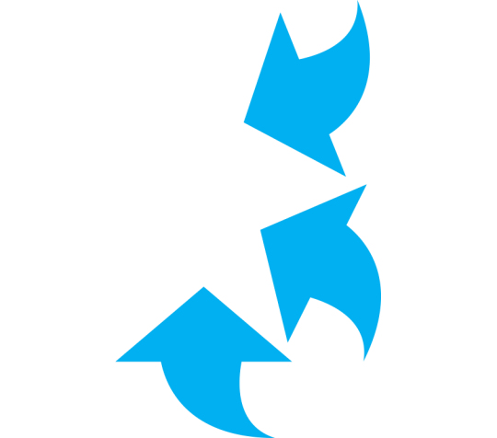
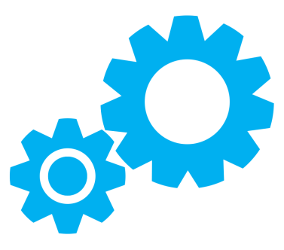
$
jjones@netatlantic.com
Notes:
It is for this reason that 56% of businesses say they plan to increase their use of email marketing in 2013.
<click>

Slide 14
“56% of businesses say they
plan to increase their use of
email marketing in 2013.”
~ Source: The small and midsize business email marketing survey, 2013
jjones@netatlantic.com
Notes:
It is for this reason that 56% of businesses say they plan to increase their use of email marketing in 2013.
<click>

Slide 15
Have Them At
Hello
jjones@netatlantic.com
Notes:
Concept number 2 is “Have them at hello”, which is about reaching your audience earlier in the decision stage. You follow your customer’s behavior from the moment they hit your landing page or make their first purchase.
<click>

Slide 16
Track visitor behavior
jjones@netatlantic.com
Notes:
You track visitor behavior at every point of engagement by having your email campaign direct them to great content throughout your various channels and give them reasons to keep coming back. Whether it is to read your latest blog, watch an informational video or download a white paper, great content is key to subscriber engagement. As a marketer, your email marketing tool will allow you to track clicks, opens, page views, bounces, forwards, etc. This incoming behavioral data about your subscribers will help you learn how to segment your audience and engage them with even deeper granularity.
<click>

Slide 17
Clicks
Opens
Views
Track visitor behavior
Bounces
Forwards
jjones@netatlantic.com
Notes:
You track visitor behavior at every point of engagement by having your email campaign direct them to great content throughout your various channels and give them reasons to keep coming back. Whether it is to read your latest blog, watch an informational video or download a white paper, great content is key to subscriber engagement. As a marketer, your email marketing tool will allow you to track clicks, opens, page views, bounces, forwards, etc. This incoming behavioral data about your subscribers will help you learn how to segment your audience and engage them with even deeper granularity.
<click>
<click>

Slide 18
Actively Engaged
Subscribers
Potential
Subscribers
Identify
the major segments
Lapsed
Subscribers
jjones@netatlantic.com
Notes:
You can also identify three major groups your subscribers fall into:
First are the Actively Engaged subscribers. These are people who respond to your confirmation emails and answer surveys. They keep connected with you because you listen to their feedback, maintain a strong product that meets their needs and expectations, and give them compelling reasons to compare you favorably with competitors by engaging them with relevant content across your channels.
<click>
Next are the Potential subscribers. They may have checked out your site and read some of your content, but rarely make a purchase. They are connected but only in a superficial way. They will need incentives to engage further to see you as a trusted resource.
<click>
Finally you have Lapsed subscribers, who were interested at one time but are no longer. They may be part of your mailing list but you should not consider them active just because you have contact info. They will require targeted reengagement, perhaps through a link to a Press Release highlighting your latest product or product enhancements.
Tracking helps you engage customers with relevant content, which leads to a good sender reputation, better compliance scores, and higher engagement.
<click>

Slide 19
Make It
Personal Using
Automation
jjones@netatlantic.com
Notes:
Number 3 is Make it Personal using Automation.
Automation is a core component of multi-channel engagement. It turns your email campaign into a powerful relationship management tool by using customer behavior to trigger messages. This raises relevance, because your campaign responds to your customers when you are foremost on their minds.
The best way to describe this is to show what I’m talking about.
<click>

Slide 20
Action
Segment
Welcome Email
Action
Revenue <$10M/yr
New Lead
Action
Revenue >$10M/yr
Manual Sales
jjones@netatlantic.com
Notes:
This flowchart illustrates an automated introductory email campaign using specific triggers and filters:
<click>
First, when a person takes an action, such as responding to a campaign, they become a lead.
<click>
The next item is a Trigger that puts leads into different Segments.
<click>
In this case, split by annual revenues of $10 Million a year.
<click><click>
Next, companies with less than $10 Million go into the automated email campaign, and are sent a welcome email and a link to one of your other channels.
<click><click>
Then, companies with greater than $10 Million in annual revenue are taken out of the automated process and into a manual queue to be contacted by a sales executive.
<click><click><click>

Slide 21
Action
Segment
Welcome Email
Action
Revenue <$10M/yr
New Lead
Action
Revenue >$10M/yr
Manual Sales
jjones@netatlantic.com
Notes:
<click>
The flow then continues.
<click>

Slide 22
Trigger
Action
Clickthrough
Qualify Lead
Action
Segment
Welcome Email
Open
Action
Action
Revenue <$10M/yr
New Lead
No Open
Whitepaper Email
Action
Revenue >$10M/yr
Manual Sales
jjones@netatlantic.com
Notes:
<click>
They will be tracked for who clicked through,
<click>
Who opened,
<click>
And who did not open the email.
<click><click>
If they click through, then you might qualify the lead and follow up manually.
<click><click>
If they do not click, the automated campaign continues by sending an invitation for a white paper or other channel asset.
This rather simple workflow is designed to provide a short overview.
<click>

Slide 23
Trigger
Action
Clickthrough
Qualify Lead
Action
Segment
Welcome Email
Open
Action
Unprecedented Detail
Action
Revenue <$10M/yr
New Lead
No Open
Whitepaper Email
Action
Revenue >$10M/yr
Manual Sales
jjones@netatlantic.com
Notes:
With the unbelievable detail now available in your data,
<click>
you can create automated campaigns that improve relevance,
<click>
raise your conversion rates,
<click>
and increase revenue.
<click>
The result is a seamless & organic flow that responds to customer activity in a way that would take thousands of sales representatives.
<click>
And the complexity is limited only by your data and your creativity.
<click>

Slide 24
Improves relevance
Trigger
Action
Raises conversions
Clickthrough
Qualify Lead
Action
Segment
Welcome Email
Open
Action
Unprecedented Detail
Action
Revenue <$10M/yr
New Lead
No Open
Whitepaper Email
Action
Revenue >$10M/yr
Manual Sales
Increases revenue
Seamless & organic
jjones@netatlantic.com
Notes:
With the unbelievable detail now available in your data,
<click>
you can create automated campaigns that improve relevance,
<click>
raise your conversion rates,
<click>
and increase revenue.
<click>
The result is a seamless & organic flow that responds to customer activity in a way that would take thousands of sales representatives.
<click>
And the complexity is limited only by your data and your creativity.
<click>

Slide 25
Trigger
Action
Action
Trigger
Action
Register
Confirm
Email
Qualify Lead
Action
Clickthrough
Qualify Lead
Delay
Clickthrough
Delay
Action
Segment
Welcome Email
Open
Three Days
Action
Action
New Member
Open
Seven Days
Reminder
Email
View Web Demo
Action
No Open
Seven Days
Webinar Email
Existing Member
Survey Email
No Open
Trigger
Action
Action
Action
Ready to Buy
Qualify Lead
Trigger
Download
Follow Up Email
Qualify Lead
More Info
Clickthrough
Not Interested
Delay
Action
Delay
Action
Fourteen Days
Whitepaper Email
Open
Seven Days
Webinar Email
No Open
jjones@netatlantic.com
Notes:
Here is an example of a campaign we actually use to follow up with people who take our free trials. It uses delays as well as triggers and actions, so you see it can get very complex.
<click>

Slide 26
Ride The
Lifecycle
jjones@netatlantic.com
Notes:
Number 4, Ride the Lifecycle describes a long-term method of tracking activity to increase the lifetime value of each customer. And I really do mean lifetime. This is achieved by aggregating customer behavior over time.
Throughout the development of email programs, it’s essential to move customers through the customer lifecycle – from acquisition to brand advocacy. Email marketing plays an important role in an effective multi-channel marketing strategy in that it can help create brand advocacy by engaging customers and driving them to higher lifetime value through increased relevancy.
<click>
People change
<click>
So do companies.
<click>
That means their needs and interests shift. Your company may offer something they need at one point and not another, or your product line expands to meet their changing needs.
<click>
With lifecycle campaigns, you seek to unite your audience with the right message as often as possible.
You can do this easily by creating an automated email campaign coupled with customized dynamic content. Inserting dynamic content into emails is a great way to personalize the customer experience, and dramatically improve the relevance of your content.
Dynamic content is information within an email that matches the demographics, preferences and/or past behavior of your subscribers. It provides a targeted way to automate delivery of relevant content which generates higher ROI for you and a better experience for recipients. More than just mail merging, dynamic content uses business rules to match appropriate content with recipients’ interests or previous behavior.
<click>

Slide 27
People change
Businesses change
Needs and Interests change
Unite audience & message
jjones@netatlantic.com
Notes:
Number 4, Ride the Lifecycle describes a long-term method of tracking activity to increase the lifetime value of each customer. And I really do mean lifetime. This is achieved by aggregating customer behavior over time.
Throughout the development of email programs, it’s essential to move customers through the customer lifecycle – from acquisition to brand advocacy. Email marketing plays an important role in an effective multi-channel marketing strategy in that it can help create brand advocacy by engaging customers and driving them to higher lifetime value through increased relevancy.
<click>
People change
<click>
So do companies.
<click>
That means their needs and interests shift. Your company may offer something they need at one point and not another, or your product line expands to meet their changing needs.
<click>
With lifecycle campaigns, you seek to unite your audience with the right message as often as possible.
You can do this easily by creating an automated email campaign coupled with customized dynamic content. Inserting dynamic content into emails is a great way to personalize the customer experience, and dramatically improve the relevance of your content.
Dynamic content is information within an email that matches the demographics, preferences and/or past behavior of your subscribers. It provides a targeted way to automate delivery of relevant content which generates higher ROI for you and a better experience for recipients. More than just mail merging, dynamic content uses business rules to match appropriate content with recipients’ interests or previous behavior.
<click>

Slide 28
Dear
Gregory,
Marcia,
%%firstname%%,
Janice,
Thank you for subscribing to our monthly All Sports newsletter.
Bicycling is all the rage right now and as we move into Fall, we have some sweet specials on bicycle gear!
We wanted to let you know about a super secret set of specials designed for the yoga enthusiast!
Yoga{ < We wanted to let you know about a super secret set of specials designed for the yoga enthusiast! /> }
Bicycle{ <Bicycling is all the rage right now and as we move into Fall, we have some sweet specials on bicycle gear!/> }
Click here for more information.
jjones@netatlantic.com
Notes:
Number 4, Ride the Lifecycle describes a long-term method of tracking activity to increase the lifetime value of each customer. And I really do mean lifetime. This is achieved by aggregating customer behavior over time.
Throughout the development of email programs, it’s essential to move customers through the customer lifecycle – from acquisition to brand advocacy. Email marketing plays an important role in an effective multi-channel marketing strategy in that it can help create brand advocacy by engaging customers and driving them to higher lifetime value through increased relevancy.
<click>
People change
<click>
So do companies.
<click>
That means their needs and interests shift. Your company may offer something they need at one point and not another, or your product line expands to meet their changing needs.
<click>
With lifecycle campaigns, you seek to unite your audience with the right message as often as possible.
You can do this easily by creating an automated email campaign coupled with customized dynamic content. Inserting dynamic content into emails is a great way to personalize the customer experience, and dramatically improve the relevance of your content.
Dynamic content is information within an email that matches the demographics, preferences and/or past behavior of your subscribers. It provides a targeted way to automate delivery of relevant content which generates higher ROI for you and a better experience for recipients. More than just mail merging, dynamic content uses business rules to match appropriate content with recipients’ interests or previous behavior.
<click>

Slide 29
jjones@netatlantic.com
Notes:
The lifecycle stages are as follows:
Awareness
Interest
Acquisition
Retention
Loyalty
Growth
These stages are the same whether or not a person is an existing customer.
Awareness is where a person becomes aware of something you’re doing.
Interest is when they seek more information about what you are doing.
Acquisition is that stage where they latch on and decide that your product is something they would buy.
Retention is the stage where a customer is willing to stay with your product as it changes and grows.
Loyalty is when customers actively seek out your company over others. At this point you do not have to win their business, but you do have to work to keep it.
Growth is the stage where a customer will advocate for you and your product, becoming a contributor to your growth.
People are in various stages depending on where they are in their lives, and where your company and product are in yours. The key here is to know what stage people are in so you can tailor your messages accordingly.
<click>

Slide 30
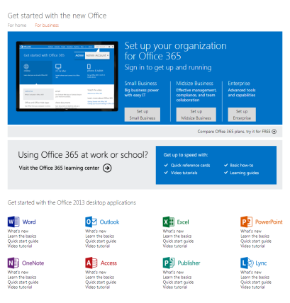
Real world example:
jjones@netatlantic.com
Notes:
And email is the way to improve your visibility with customers throughout the lifecycle. Let’s take a look at this example from Microsoft and a lifecycle campaign they’ve built for their B2B customers around MS Office. By researching customer pain points, it became apparent that users needed help getting started. Microsoft created a Getting Started Center and an automated lifecycle campaign that triggered an email to a customer within 48 hours of purchase. When the customer receives the welcome email and clicks the link to the Getting Started Center they are taken to a website that is chock full of tips and tricks. Users that engage will receive another email that is application specific within Office. For example, Excel. If they click on the link they will be brought to a short training on Excel. And because they engaged with the first Excel email, they will get another email within a few days that goes into even more detail. This will continue for a month. If they do not click on the initial Excel email, they will not receive another email until a new series starts, possibly Word or PowerPoint. The entire series takes 4.5 – 5months to complete. As you can see, the results clearly measure the success of a campaign like this and the loyalty that gets created by offering users valuable information.
<click>

Slide 31
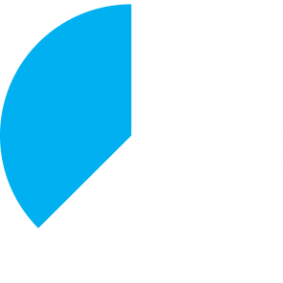
How to Best Serve Email Subscribers
Through the Entire Customer Lifecycle
Jeffrey Rice, MECLABS, and Adam T Sutton, MECLABS
~ MarketingSherpa – 2/16/2012
21x
50%
800%
Two-thirds of
participants tried
a new feature
Eight out of ten
customers learned something new
higher clickthrough rate than general emails
higher open rate
than what
Microsoft considered industry standard
higher rate than general emails about MS Office
jjones@netatlantic.com
Notes:
And email is the way to improve your visibility with customers throughout the lifecycle. Let’s take a look at this example from Microsoft and a lifecycle campaign they’ve built for their B2B customers around MS Office. By researching customer pain points, it became apparent that users needed help getting started. Microsoft created a Getting Started Center and an automated lifecycle campaign that triggered an email to a customer within 48 hours of purchase. When the customer receives the welcome email and clicks the link to the Getting Started Center they are taken to a website that is chock full of tips and tricks. Users that engage will receive another email that is application specific within Office. For example, Excel. If they click on the link they will be brought to a short training on Excel. And because they engaged with the first Excel email, they will get another email within a few days that goes into even more detail. This will continue for a month. If they do not click on the initial Excel email, they will not receive another email until a new series starts, possibly Word or PowerPoint. The entire series takes 4.5 – 5months to complete. As you can see, the results clearly measure the success of a campaign like this and the loyalty that gets created by offering users valuable information.
<click>

Slide 32
Do you track
customer activity online?
jjones@netatlantic.com
Notes:
Now we have a poll question: Do you track customer activity? You might not use it now, but plan to in the future. Through Big data you can further segment your target audience.
<click>

Slide 33
Create
Targeted
Segments
To Raise Response
jjones@netatlantic.com
Notes:
Speaking of which, concept number 5, Creating Targeted Segments, is about using the extreme detail available today to group customers with very similar interests.
These segments allow you to integrate your ecommerce, social media, mobile and web analytics data and build out complete subscriber profiles. Once you have this behavioral and transactional data funneling into your email program, you can create segments based on actions taken at each stage of the customer lifecycle.
By creating these segments can cut your list from millions of readers to thousands, and further segmentation refines that list down to maybe dozens.
The benefit of segmentation is that it greatly improves message relevance and response rates.
<click>

Slide 34
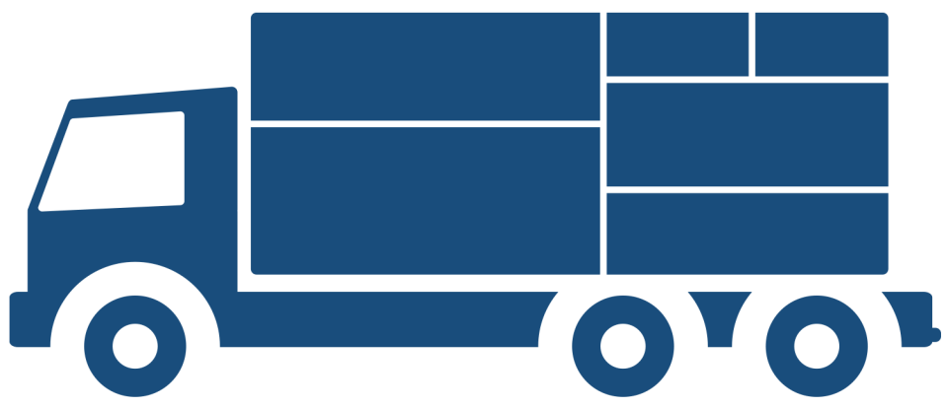
Use data to its full potential
Make segments dynamic
Use multiple factors
Strengthen your message
jjones@netatlantic.com
Notes:
You can use Big data to its full potential to really drill down to find unique customer interests.
<click>
Dynamic segments are groups you set up in your email solution that grow and shrink constantly as people’s interests shift, depending on criteria you’ve already set.
<click>
Each segment might be described by multiple factors,
<click>
Segmentation means you don’t have to water down your messages to include everybody, but can tailor each campaign for one group
<click>
Ultimately, by tracking your customer’s behavior, needs and interests, you keep your customer engaged and in charge.
<click>

Slide 35
jjones@netatlantic.com
Notes:
Current email marketing tools let you store more detailed data and run very tightly messaged campaigns. Let’s say you are a fleet truck distributor. You broker both new and used trucks for your customer base who then use them for various functions; such as moving, towing, transporting goods, etc.
As a broker, you just learned about a large inventory of various sized box trucks and you want to specifically target your customers who rent their trucks out to “do it yourself” movers. You know which customers fit this niche, which dynamically grows and shrinks, based on the data provided back to you by their prior engagement with your emails and content. Segmentation means that you can create a targeted group for this segment of your subscribed list. It knows and learns as your engagement level deepens.
<click>
<click>

Slide 36
jjones@netatlantic.com

Slide 37
Relevancy raises ROI
jjones@netatlantic.com
Notes:
Segmentation opens a ton of potential for raising engagement. While some companies use multi-channel engagement in their day-to-day, today – many companies may be new to the concept. Companies can use a mix of different marketing channels to reach their intended audience, and appeal to them with a campaign that is meant for their exact profile. You aren’t trying to be all things to all people, just one thing to your targeted audience. This level of relevancy greatly raises the ROI of your marketing campaigns.
<click>

Slide 38
jjones@netatlantic.com

Slide 39
Keep It
Short
And Sweet
jjones@netatlantic.com
Notes:
Number 6, Keep it Short and Sweet is about using email in a new and different way. Instead of large email newsletters that announce a new product or event, and, by the way, push your press release, flog your blog and your newest web demo, you keep your messages short, with a single call to action.
<click>

Slide 40
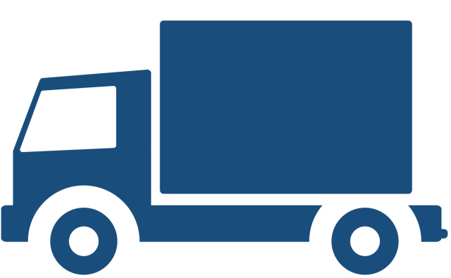
Keep the acquisition path clear
Run campaigns more often
Scale down the message
Increase impact
jjones@netatlantic.com
Notes:
You know as a marketing professional that shortening a message takes a surprising level of discipline
<click>
to keep the idea simple and the acquisition path clear.
<click>
But the result is that you can send emails more often,
<click>
allowing you to scale down the message.
<click>
The result is a greater mental impact and a deeper level of relationship with your customers.
<click>

Slide 41
jjones@netatlantic.com
Notes:
Take an example of a newsletter that has three topics. This dilutes the impact of each.
<click>
The third topic obviously suffers the most.
<click>
You might break this out into three different messages,
<click>
sent once per week or so.
<click>
Combined with segmentation and automation, your entire list doesn’t need to see every email, so the actual level of inbox inundation is a bit less than it would seem.
Keeping your messages to just one idea can have a large impact on your overall marketing strategy.
<click>

Slide 42
Amplify
each opportunity
jjones@netatlantic.com
Notes:
The point is that simple messages let you contact people more frequently, amplifying the importance of each message, and raising the value of each opportunity.
<click>

Slide 43
Do you segment
your audience?
jjones@netatlantic.com
Notes:
Now we have another poll question: Do you segment your audience? By region, industry, company size, role, or product line. You may not yet but are considering it in the future.
<click>

Slide 44
Keep Your
Eyes
Wide Open
jjones@netatlantic.com
Notes:
Number 7 is about Keeping your Eyes Open Wide through Feedback Immersion. Obviously, you know the value of surveys and customer feedback. You want to learn everything you can about your customers at all times. Even if you can put your business in the right place at the right time, you still need the right message.
<click>

Slide 45
Know your customers
Discover new ideas
Understand challenges & needs
Optimize customer service
jjones@netatlantic.com
Notes:
Number 7 is about Keeping your Eyes Open Wide through Feedback Immersion. Obviously, you know the value of surveys and customer feedback. You want to learn everything you can about your customers at all times. Even if you can put your business in the right place at the right time, you still need the right message.
<click>
Feedback helps you know your customers.
<click>
It helps you discover new ideas.
<click>
You learn to understand your customers’ pain points and needs.
<click>
And you can optimize your customer service to meet those needs.
<click>
Developing lasting customer relationships helps you gain a competitive edge. This is why you should survey your subscribers often, even if it means hearing feedback you won’t like.
<click>
This will help you gain a competitive edge.
<click>

Slide 46
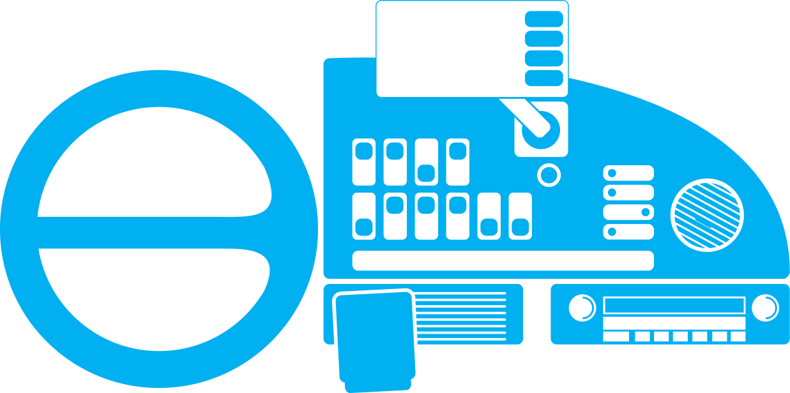
ENGAGE
INTERACT
LEARN
MEASURE
TEMP
FUEL
OIL
BRAKE
ENGINE
AC
jjones@netatlantic.com
Notes:
Measuring customer satisfaction is a continuous process. Like the dashboard of your car, which communicates information and provides feedback about the various systems in your car, feedback about your products and services involves more than just the customer service department. Every part of the organization can be involved in surveys and feedback.
<click>
Your billing department touches customers,
<click>
as does your sales & marketing group. Obviously, sales has the most constant engagement with customers, and when as a marketing professional, your salespeople tell you what they are hearing from customers, you become the lightning rod for new ideas, suggestions and complaints.
<click>
Your product development group can also learn a great deal about the direction of the company by engaging customers on a regular basis.
<click>
Each group can interact with your audience using surveys and email.
<click>
Your communications should be frequent, but also quick and easy. You know how to write a survey. Email helps you use them more often and send them to the right segments.
<click>

Slide 47
Improve
loyalty & retention
jjones@netatlantic.com
Notes:
Surveys help you understand exactly how to engage customers, so you can improve customer loyalty and retention.
The feedback you get from your customers isn't just important for you, it's important for them, as well. If you listen to what your customers are saying and improve their experience with your products and services, everybody wins. You get more loyal customers and they get what they really need and want.
<click>

Slide 48
Get
Continuous
Permission
jjones@netatlantic.com
Notes:
Number 8, Get Continuous Permission is about a shift in the way you engage your mailing list. Expressed permission is when an individual has opted-in or specifically requested to get your emails. Some examples include:
· Anyone who goes through a double opt-in or confirmed opt-in process
· Someone who subscribes via your website to receive your email communications
· People who sign up via social media and mobile where you inform them you'll be engaging them through email
Seth Godin, a well-known authority and author, entrepreneur, marketer, and public speaker says, “Permission marketing is the privilege (not the right) of delivering anticipated, personal and relevant messages to people who actually want to get them.”
Marketers need to think about how they acquire—and keep—customer permissions to ensure the long-term success of their marketing efforts. Although rare, there is the occasional marketer who thinks that asking for continuous permission isn't really necessary. But getting consent to communicate in multiple ways creates a more engaged, complementary, and transparent relationship.
Permission should be requested every time an interaction occurs with the customer or prospect, clearly putting them in control of the interaction. Customers and prospects are willing to engage in a two-way dialog with the companies they prefer, but only when they are given meaningful choices for how and when those exchanges take place.
Return Path recommends that you implement a strategy to get subscribers to renew their permission with your email program, ideally in combination with a preference center, to find out what subscribers want to receive, if anything, and when.
You can capture multi-channel communication preferences whenever a subscriber signs up on your Facebook page, in a store, and via email and mobile. But the best way is to make a preference center available online where they can clearly indicate their desire to receive your messages across multiple channels.

Slide 49
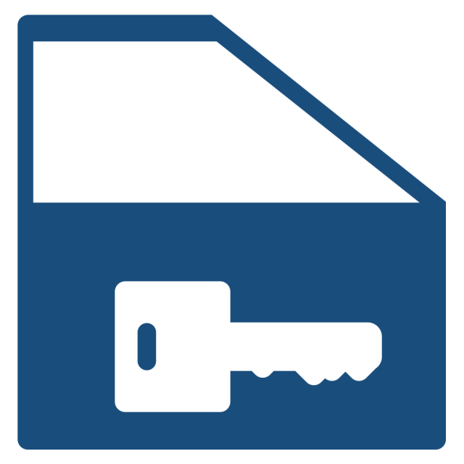
“Permission marketing is the privilege
(not the right) of delivering anticipated,
personal and relevant messages to
people who actually want to get them.”
~ Seth Godin
Author, Entrepreneur, Marketer and Public Speaker
jjones@netatlantic.com
Notes:
It is for this reason that 56% of businesses say they plan to increase their use of email marketing in 2013.
<click>

Slide 50
Strong lists raise response
Strengthen compliance
Improve deliverability
Engage the ones who say “Yes”
jjones@netatlantic.com
Notes:
Within your emails, instead of just including an unsubscribe link in the footer, you ask for the right to continue the relationship somewhere more prominent, in every email. Instead of re-engaging customers every 6 months or so, ask permission every time.
<click>
As ISPs get better at honing SPAM filters to identify legitimate and non-legitimate email,
<click>
A strong, compliant list is more important than ever because it gets the best response rates.
<click>
Continuous permission strengthens your compliance practices,
<click>
Helping you improve deliverability, which now rival open rates and clickthroughs as an important campaign metric. Deliverability is determined by many factors including previous bounce rates, subject lines, and SPAM complaints.
<click>
Many people may say no to a permission request,
<click>
But you want to engage the ones who say “Yes”, because they are the ones who will give you most of your business growth. This is why getting continuous permission is imperative.
<click>

Slide 51
Ex. 1: Confirm above text
jjones@netatlantic.com
Notes:
One example of continuous permission is where it appears at the beginning of the email. This is very straightforward and obvious, and unlikely to offend a reader.
<click>

Slide 52
Ex. 2: Confirm within text
jjones@netatlantic.com
Notes:
The next example shows the permission request built into the content. This hides the intent somewhat, and may result in reduced confirmations. But it requires a higher level of engagement. You should not fear reducing the size of your list by asking for permission more often. If you use the concepts described in this white paper to maximize your customer engagement, your response will likely improve.
<click>

Slide 53
Deliver
Support
Services
jjones@netatlantic.com
Notes:
Our final concept is about “Delivering Support Services”. It’s better practice to proactively reach out and offer your assistance to your audience. As you look to compete on quality of service, your customers’ growing desire for multiple methods of interaction requires development of a customer support strategy that incorporates multiple channels in a smart and targeted way. By integrating channels, you can empower customers to interact when, where and how they want, while ensuring a consistent, reliable and seamless experience.
When you deliver Support Services on a silver platter, with email marketing activities like offers to help, product updates, training courses and other service related content you will strengthen your relationships with your customers, similar to the Microsoft example I cited earlier.
Another great example of this is Salesforce dot com, which periodically sends out messages from a customer success team, soliciting support tickets. They’ve discovered two things: Instead of waiting for angry calls, it’s better to defuse issues before they arise. Second, it lowers response times, because customers call with issues that are more minor than the ones they actively contact Salesforce about. So the problems are easier to solve.
<click>

Slide 54
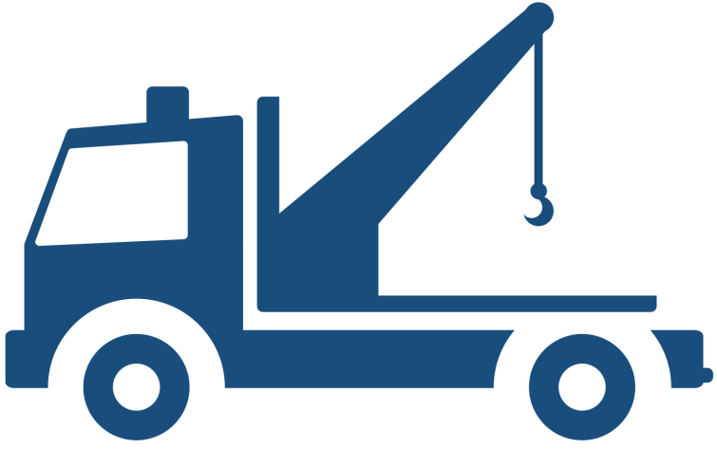
Real world example:
jjones@netatlantic.com
Notes:
This is a way to use Email for a proactive approach.
<click>
It helps you to maintain continuous touch with customers,
<click>
And even expand relationships.
<click>
Instead of waiting for irate callers, you can defuse potential problems.
<click>
The bottom line is you are telling customers, “We are here and we are engaged.”
<click>

Slide 55
Proactive approach
Continuous touch
Expand relationships
“We are here and we are engaged.”
jjones@netatlantic.com
Notes:
This is a way to use Email for a proactive approach.
<click>
It helps you to maintain continuous touch with customers,
<click>
And even expand relationships.
<click>
Instead of waiting for irate callers, you can defuse potential problems.
<click>
The bottom line is you are telling customers, “We are here and we are engaged.”
<click>

Slide 56
Unleash The
Power of
Email
jjones@netatlantic.com

Slide 57
Email ties it all together
jjones@netatlantic.com
Notes:
So Multi-channel Engagement helps you deepen your customer relationships and turn leads into sales opportunities.
<click>
It is what happens when you tie all of these concepts together using email.
<click>
It helps you listen to the customer more frequently, to learn, and deliver targeted messages with timely and relevant content
<click>
and solutions to address their interests and needs at the right time... consistently.
<click>
When you engage people throughout the relationship, you raise the level of participation
<click>
And you also build trust.
<click>
Customers engage more deeply with companies that listen to their needs.
<click>
Combining these tactics adds up to a new approach: Drive business forward.
<click>
Captivate them.
<click>
That’s Multi-channel Engagement.
<click>

Slide 58
Deliver targeted information
Understand needs & interests
Drive business forward
Email ties it all together
Captivate your audience
Raise participation
Deepen relationships
jjones@netatlantic.com
Notes:
So Multi-channel Engagement helps you deepen your customer relationships and turn leads into sales opportunities.
<click>
It is what happens when you tie all of these concepts together using email.
<click>
It helps you listen to the customer more frequently, to learn, and deliver targeted messages with timely and relevant content
<click>
and solutions to address their interests and needs at the right time... consistently.
<click>
When you engage people throughout the relationship, you raise the level of participation
<click>
And you also build trust.
<click>
Customers engage more deeply with companies that listen to their needs.
<click>
Combining these tactics adds up to a new approach: Drive business forward.
<click>
Captivate them.
<click>
That’s Multi-channel Engagement.
<click>

Slide 59
Email fuels
Multi-channel
Engagement
jjones@netatlantic.com
Notes:
So Multi-channel Engagement helps you deepen your customer relationships and turn leads into sales opportunities.
<click>
It is what happens when you tie all of these concepts together using email.
<click>
It helps you listen to the customer more frequently, to learn, and deliver targeted messages with timely and relevant content
<click>
and solutions to address their interests and needs at the right time... consistently.
<click>
When you engage people throughout the relationship, you raise the level of participation
<click>
And you also build trust.
<click>
Customers engage more deeply with companies that listen to their needs.
<click>
Combining these tactics adds up to a new approach: Drive business forward.
<click>
Captivate them.
<click>
That’s Multi-channel Engagement.
<click>

Slide 60
jjones@netatlantic.com

Slide 61
About
Net Atlantic
jjones@netatlantic.com

Slide 62
Custom solutions
Personalized service
Reputation
Email Marketing Suite
Professional Services
Enterprise performance
SaaS pricing
jjones@netatlantic.com
Notes:
Before taking your questions, I’d like to share a little more information about Net Atlantic.
Net Atlantic was founded in 1995 as an internet services provider.
<click>
Today, we offer powerful Email Marketing tools tailored for every organization, regardless of the size of your company or the complexity of your email marketing needs. Our focus is on the SMB market and email marketing is all we do – so we understand your needs. We offer you Enterprise services at SaaS pricing.
<click>
And a server base that helps us get very high deliverability rates because of our commitment to compliance with a dedicated team and a reputation we have established through the years with the various ISPs.
<click>
Our email marketing tools offer highly customizable tracking & reporting,
<click>
And we also offer rich, dynamic segmentation.
<click>
We offer fully automated email campaigns using behavioral triggers and sequenced mailings.
<click>
Offline, we are dedicated to providing Professional services and offer a variety of Service Packages to ensure your success, including training, list cleansing, customized templates, Campaign Deployment and Email Deliverability Monitoring & Resolution
<click>
We also offer dedicated email marketing servers to improve control for larger clients.
<click>
And we use our email marketing tools as the basis for providing Multi-channel Engagement to our clients.
<click>
For more information, visit us at www.netatlantic.com, email sales@netatlantic.com, or contact an account executive toll-free at 877-263-8285.
And now let me get to your questions.
<click>
If I can’t get them to all, I will be sure to answer all your questions via email, after the session.
<click>

Slide 63
877-263-8285
sales@netatlantic.com www.netatlantic.com
jjones@netatlantic.com
Notes:
Before taking your questions, I’d like to share a little more information about Net Atlantic.
Net Atlantic was founded in 1995 as an internet services provider.
<click>
Today, we offer powerful Email Marketing tools tailored for every organization, regardless of the size of your company or the complexity of your email marketing needs. Our focus is on the SMB market and email marketing is all we do – so we understand your needs. We offer you Enterprise services at SaaS pricing.
<click>
And a server base that helps us get very high deliverability rates because of our commitment to compliance with a dedicated team and a reputation we have established through the years with the various ISPs.
<click>
Our email marketing tools offer highly customizable tracking & reporting,
<click>
And we also offer rich, dynamic segmentation.
<click>
We offer fully automated email campaigns using behavioral triggers and sequenced mailings.
<click>
Offline, we are dedicated to providing Professional services and offer a variety of Service Packages to ensure your success, including training, list cleansing, customized templates, Campaign Deployment and Email Deliverability Monitoring & Resolution
<click>
We also offer dedicated email marketing servers to improve control for larger clients.
<click>
And we use our email marketing tools as the basis for providing Multi-channel Engagement to our clients.
<click>
For more information, visit us at www.netatlantic.com, email sales@netatlantic.com, or contact an account executive toll-free at 877-263-8285.
And now let me get to your questions.
<click>
If I can’t get them to all, I will be sure to answer all your questions via email, after the session.
<click>

