Slide 2
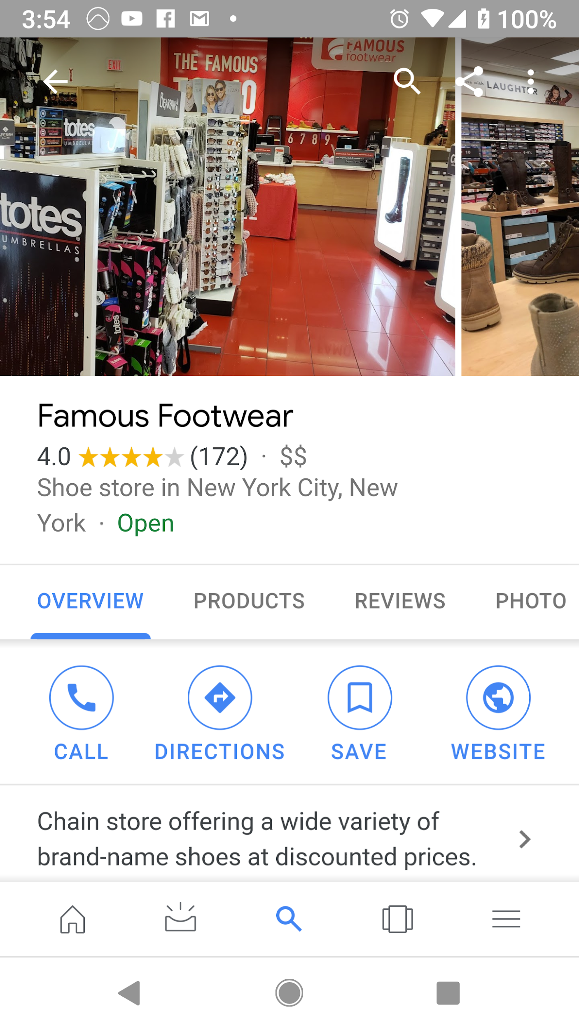
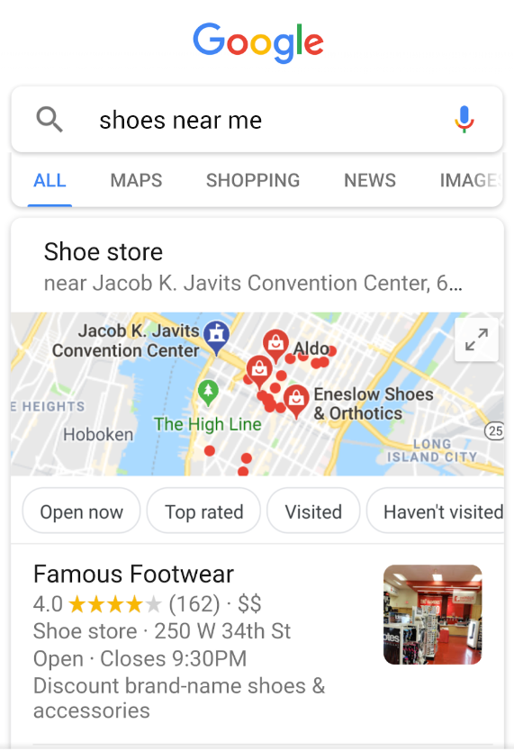

Slide 4
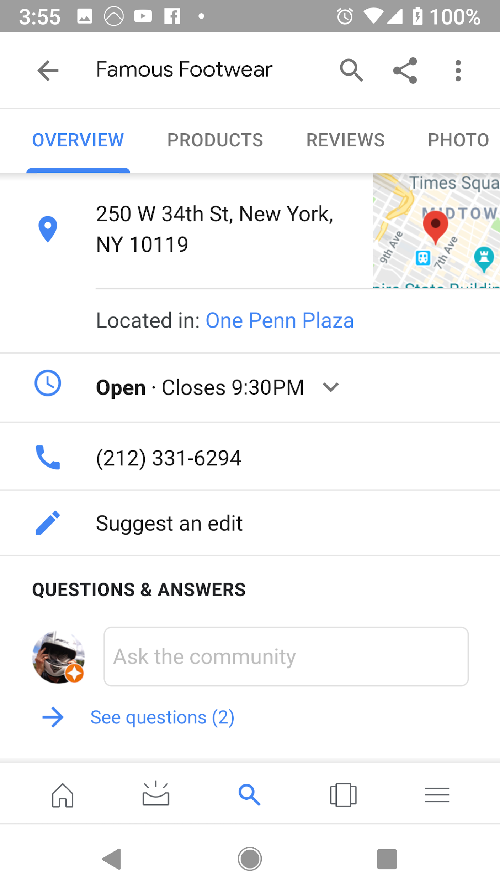

Slide 5
Wayne
Regional Operations Manager
Franchise

Slide 6
\
Pat
Store Manager
Outdoor Lifestyle

Slide 7
Ruth
General Manager
Fashion Brand

Slide 8
Mike
Store Associate Team Lead
Sporting Goods

Slide 9
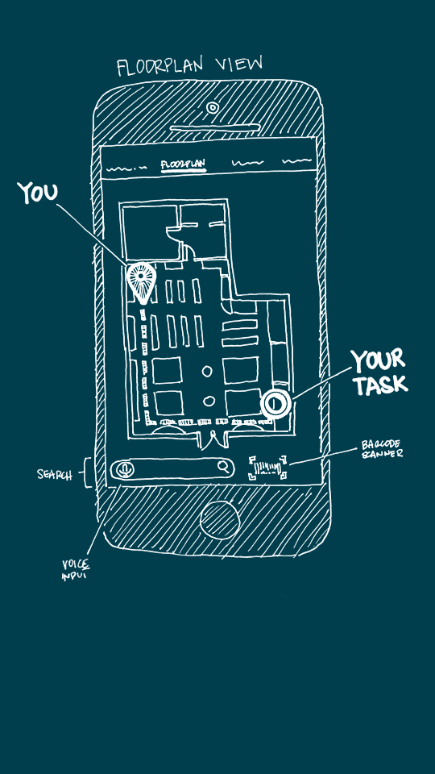

Slide 10
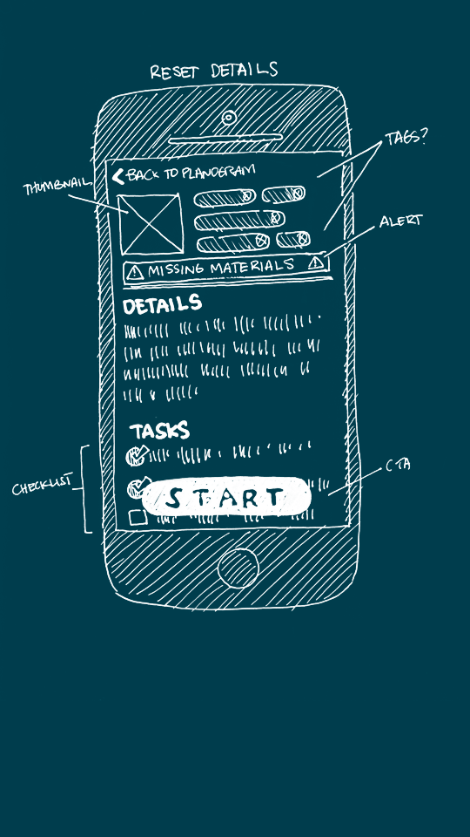

Slide 11
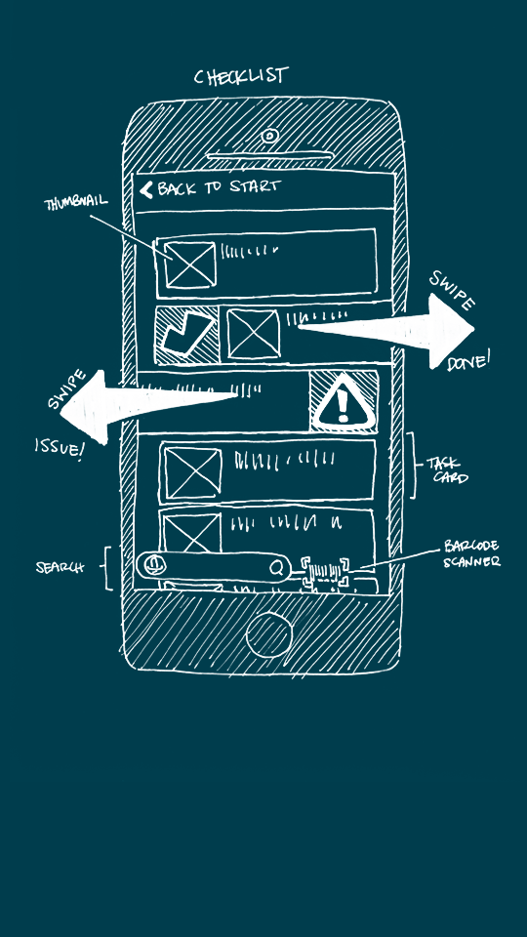

Slide 12
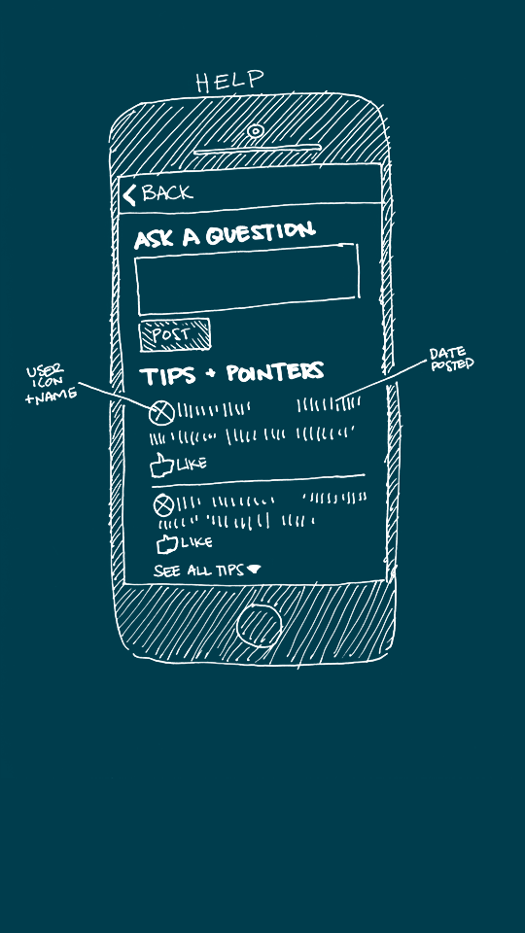

Slide 13
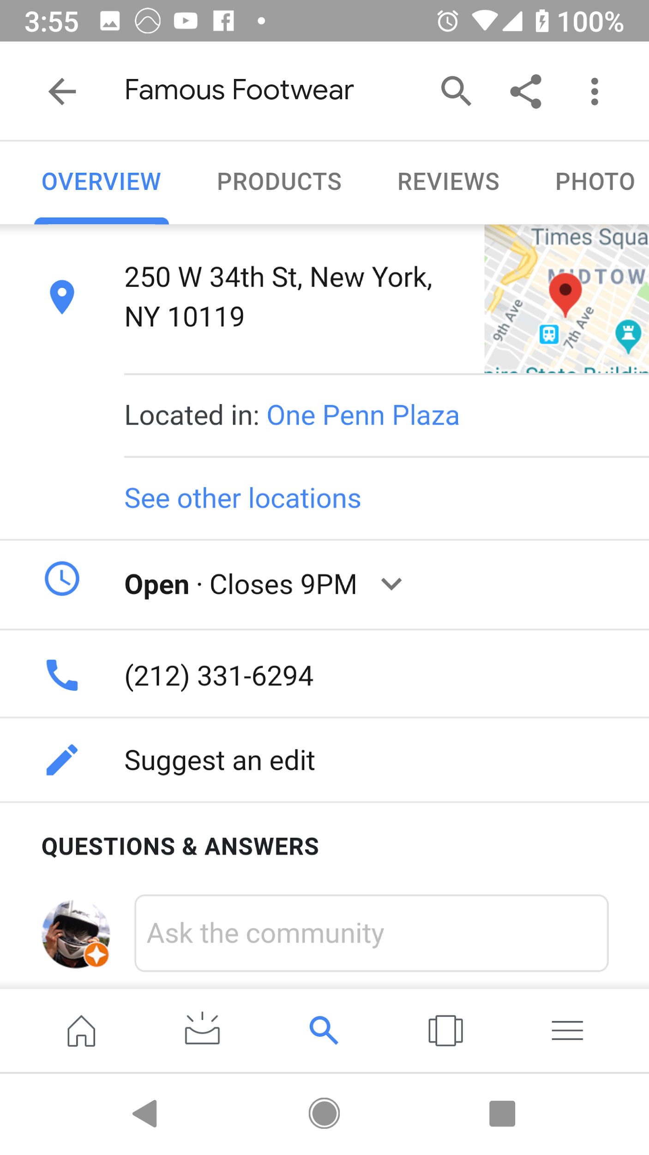
SWITCH TO DEMO

Slide 14
\
Pat
Store Manager
Outdoor Lifestyle

Slide 15
Christy
Shift Lead
Home Improvement

Slide 16
Bob
Senior Sales
Associate
Health & Beauty

Slide 17
Wayne
Regional Operations Manager
Franchise

