Slide 2
BEFORE WE GET STARTED:
Submit questions using the “Questions” feature through the webinar dashboard
All attendees are on mute
This webinar is being recorded
All attendees will receive a link to the recording after the webinar

Slide 5
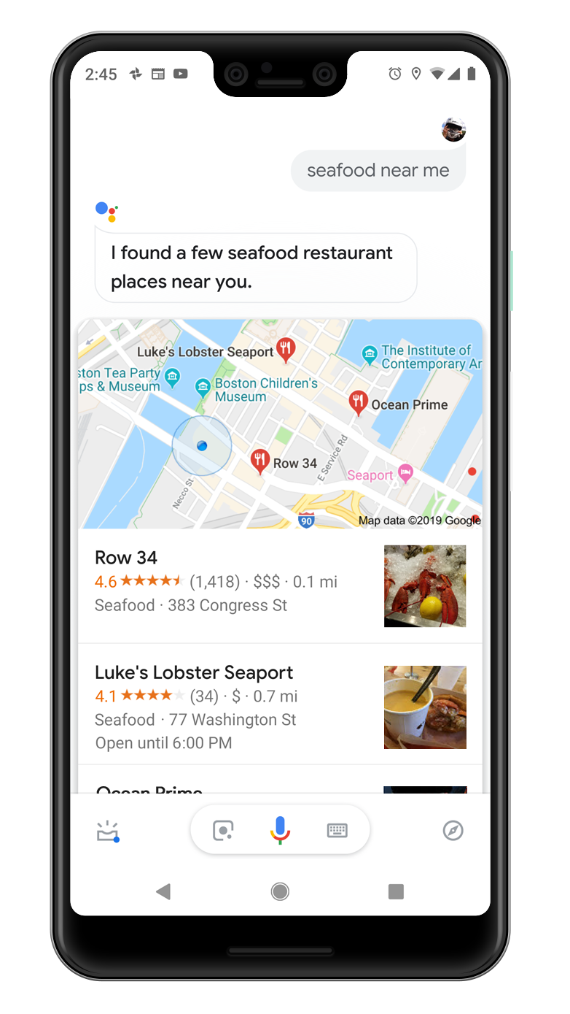
“Hey,Google…”

Slide 6
KNOWS ME

Slide 7
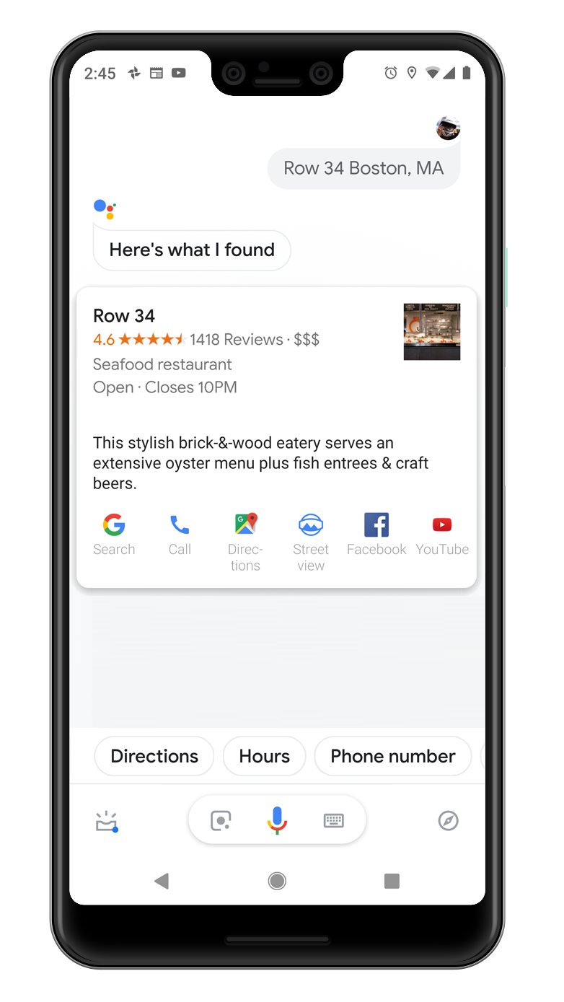
UNDERSTANDS I’M BUSY

Slide 8
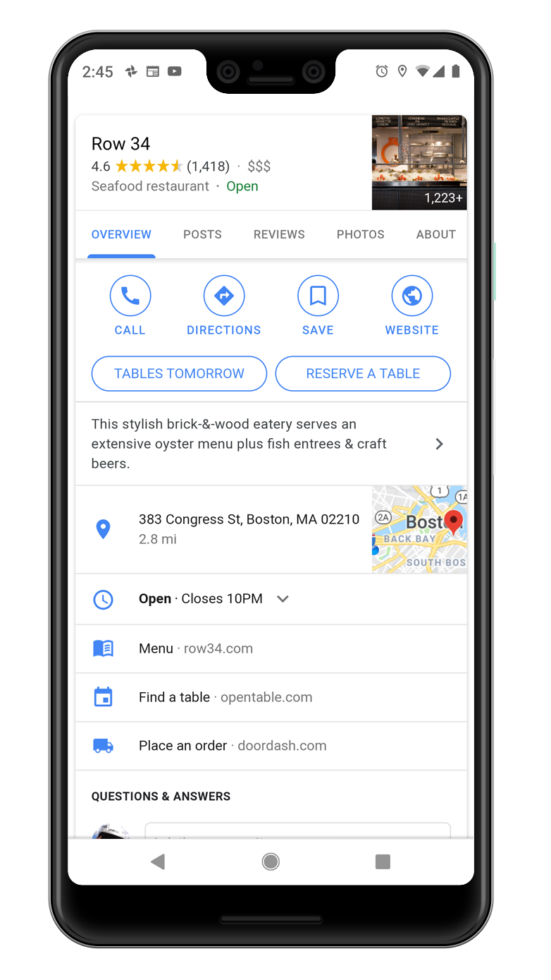
ANTICIPATES MY NEEDS

Slide 9
HARVESTS THE WISDOM OF THE CROWD TO HELP

Slide 11
Wayne
Regional Operations Manager
Franchise

Slide 12
Pat
\
Store Manager
Outdoor Lifestyle

Slide 13
Ruth
General Manager
Fashion Brand

Slide 14
Mike
Store Associate Team Lead
Sporting Goods

Slide 15
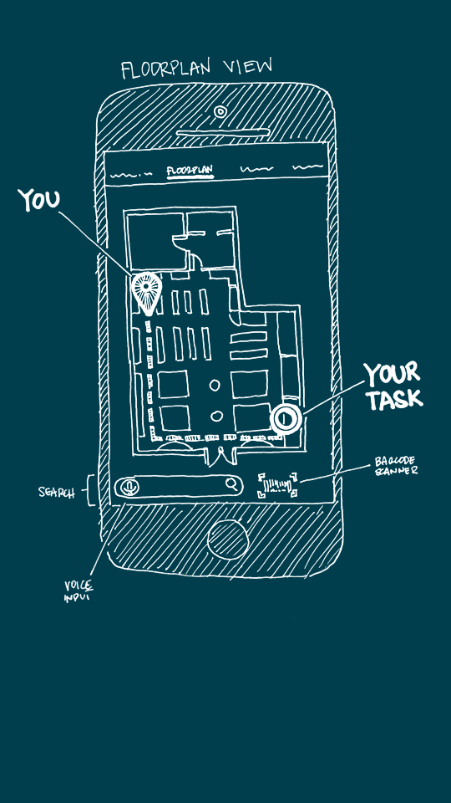
KNOWS YOU

Slide 16
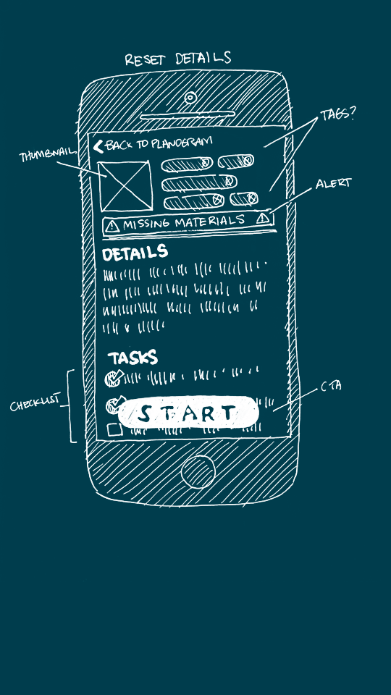
KNOWS YOU’RE BUSY

Slide 17
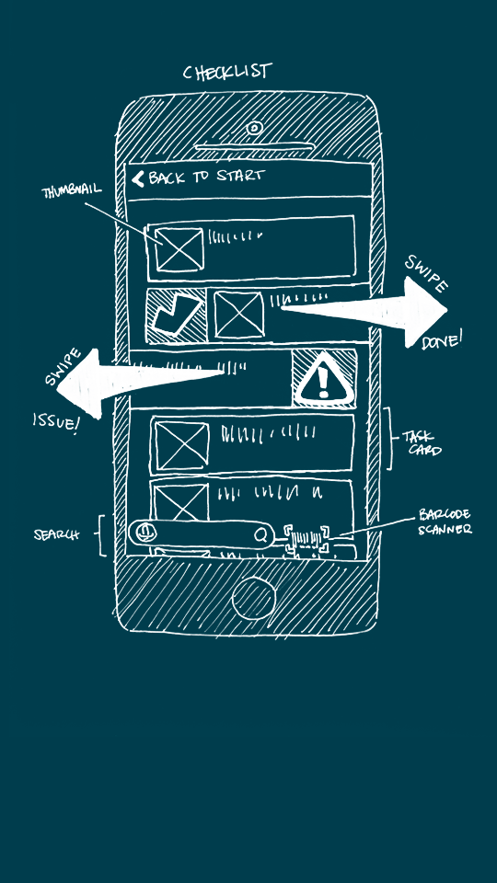
ANTICIPATES ACTIONS

Slide 18
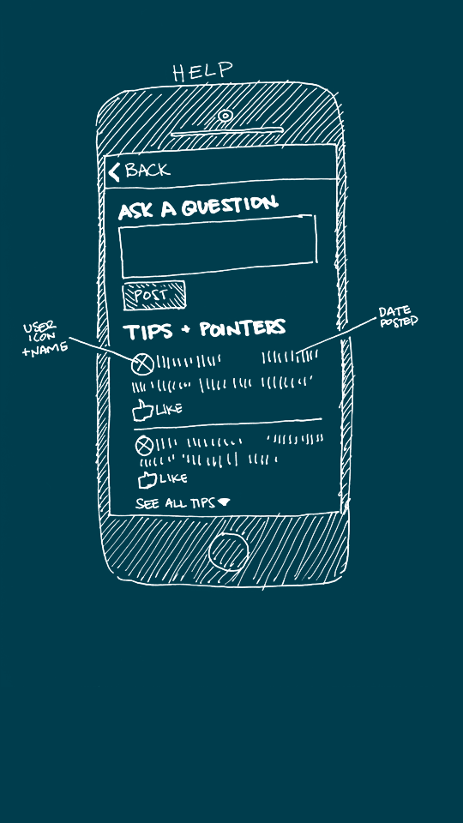
HARVESTS STORE KNOWLEDGE

Slide 19
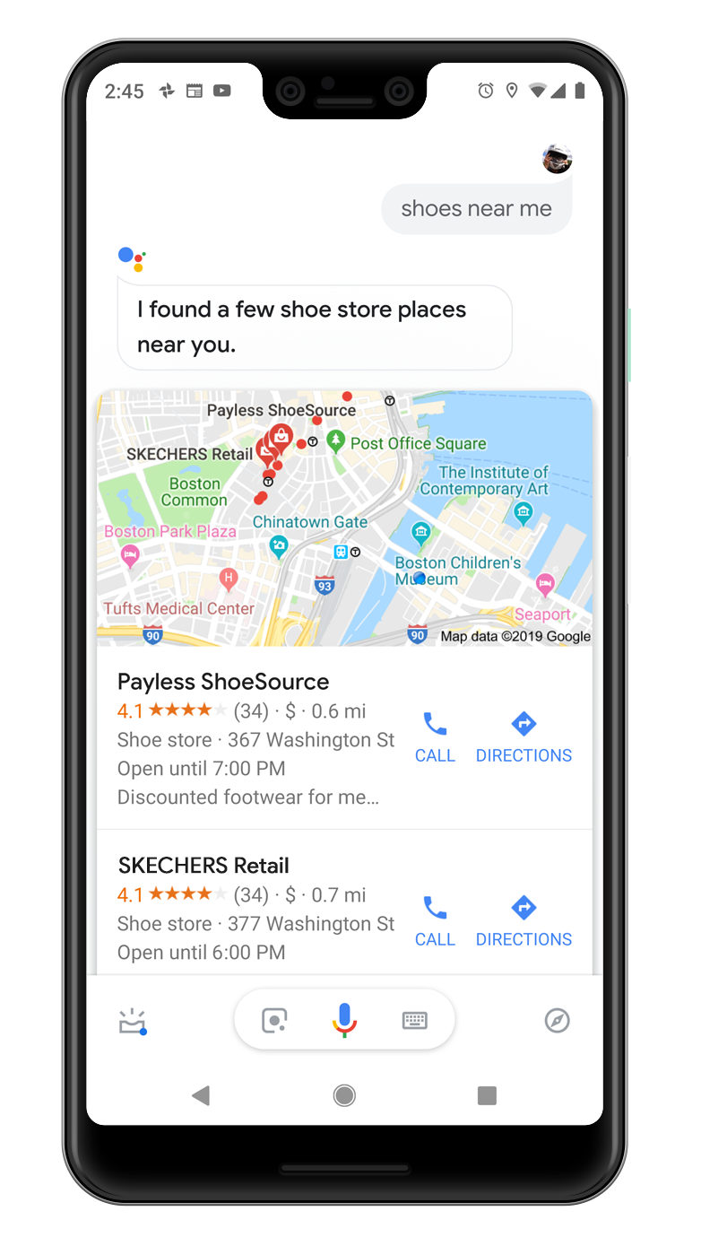
COMPASS IN ACTION

Slide 20
Pat
\
Store Manager
Outdoor Lifestyle

Slide 21
Christy
Shift Lead
Home Improvement

Slide 22
Bob
Senior Sales Associate
Health & Beauty

Slide 23
Wayne
Regional Operations Manager
Franchise

Slide 25
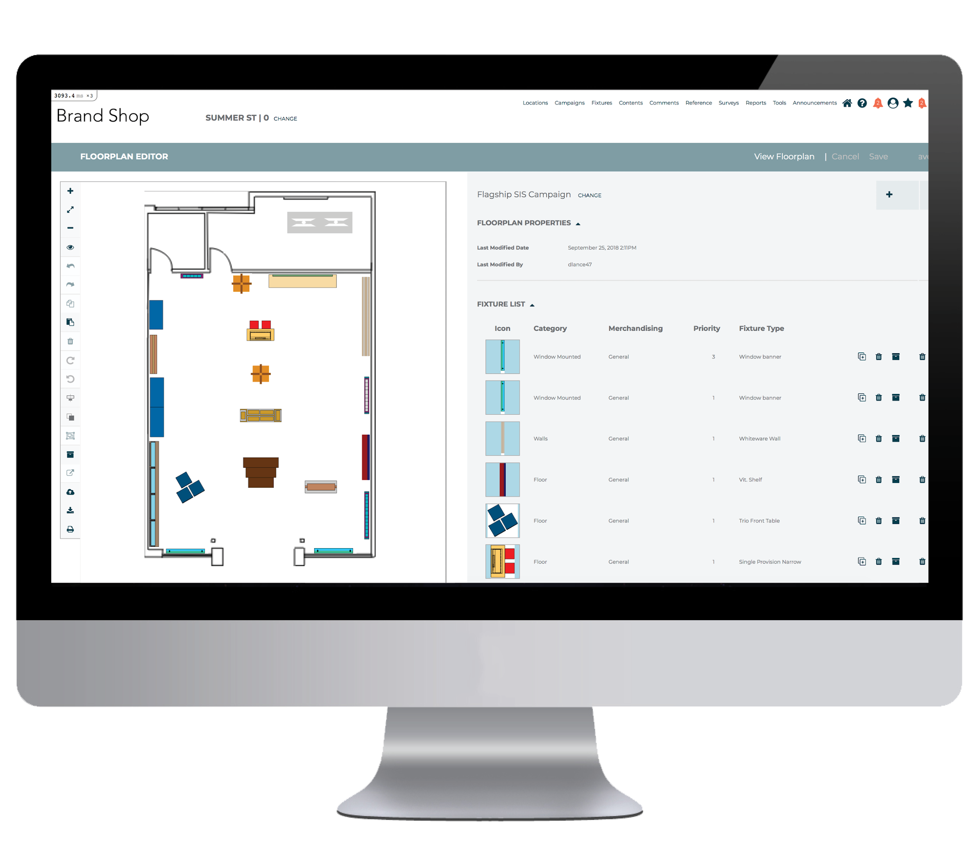
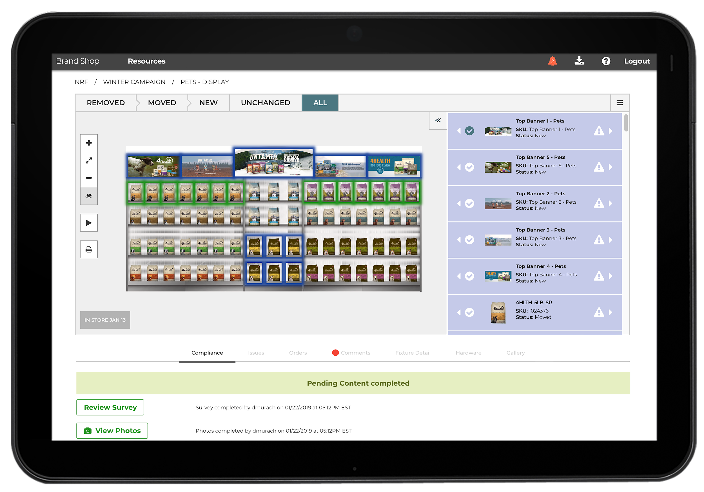
MERCHANDISING CLOUD
Streamlining how HQ and store teams create, communicate, execute, and confirm visual merchandising plans
Notes:
Thanks Susan. Bringing merchandising superpowers to store associates is a critical requirement for retailers looking to transform, and deliver a more localized and agile merchandising process.
This demonstration of our Compass concept is meant to spark a conversation, and show you the direction we’re headed here at One Door. But it’s not JUST a concept. Many of the capabilities you just saw - that guide associates, and tailor information just for them - are available in our Merchandising Cloud application today.

Slide 26
GIVE YOUR STORE ASSOCIATES MERCHANDISING SUPERPOWERS
w w w . o n e d o o r . c o m
Notes:
If you are interested in learning more about the application, you can contact us at www.onedoor.com.
Now, we’ve got lots of questions teed up, so let’s dig in.

Slide 27
Q&A SESSION
Please submit your questions through the “Questions” feature on your webinar dashboard
Notes:
Please submit your questions through the Q&A feature on your meeting dashboard, we’ll try to get to as many questions as we have time for.

